Slide 1
Unit 5
Storage Management

Slide 2
File Systems
3 criteria for long-term information storage:
  Should be able to store very large amount of information
  Information must survive the processes using it
  Should provide concurrent access to multiple processes
Solution:
  Store information on disks in units called files
  Files are persistent, and only owner can explicitly delete it
  Files are managed by the OS
File Systems: How the OS manages files!
A File system is the data structure that an operating system uses to keep track of files on a disk or partition

Slide 3
File Naming & Extensions
Each file is associated with a name
Name divided into 2 parts, first part the name and second part is the extension
On UNIX, extensions are not enforced by OS
  However C compiler might insist on its extensions
    These extensions are very useful for C
Windows attaches meaning to extensions
  Tries to associate applications to file extensions

Slide 4
File Attributes
File-specific info maintained by the OS
  File size, modification date, creation time, etc.
  Varies a lot across different OSes
Attributes
  Name – only information kept in human-readable form
  Identifier – unique tag (number) identifies file within file system
  Type – needed for systems that support different types
  Location – pointer to file location on device
  Size – current file size
  Protection – controls who can do reading, writing, executing
  Time, date, and user identification – data for protection, security, and usage monitoring

Slide 5
Basic File Operations
Create a file
Write to a file
Read from a file
Seek to somewhere in a file
Delete a file

Slide 6
Info Associated with File Open
  File pointer
  File Count / Link Count
  Disk location of the file
  Access rights & locks
File Types
  Executable
  Object
  Source Code
  Batch
  Text
  Library
  Print or view
  Archive
  Multimedia

Slide 7
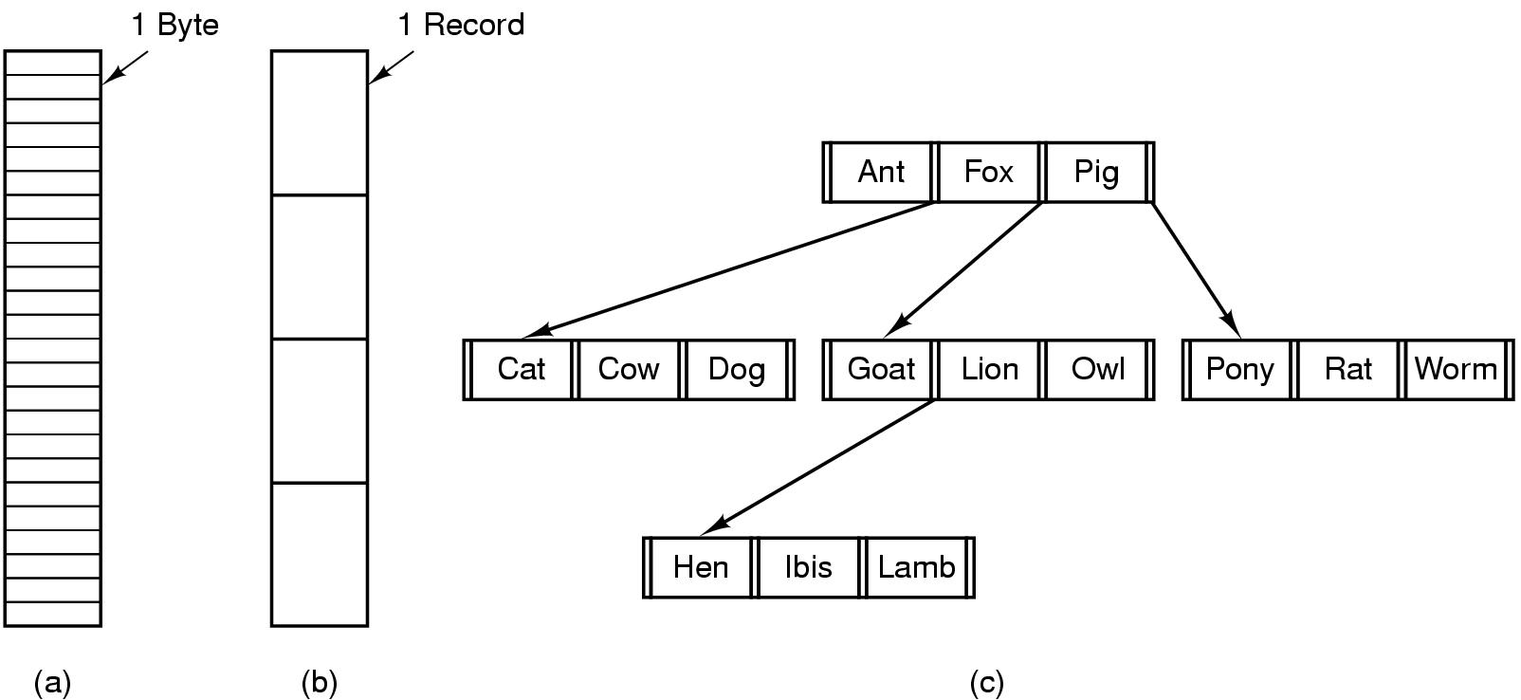
Internal File Structure
Byte Sequence: unstructured
Record sequence: r/w in records, relates to sector sizes
Complex structures, e.g. tree
  - Data stored in variable length records; OS specific meaning of each file

Slide 8
File Access
Sequential access
  read all bytes/records from the beginning
  cannot jump around, could rewind or forward
  convenient when medium was magnetic tape
  editors and compilers usually access files in this fashion
  read next, Writenext, Reset
Random access
  bytes/records read in any order
  essential for database systems
Read(n) , Write(n), position to n [then uses readnext, writenext]
n represents the block number

Slide 9

FS on disk
Could use entire disk space for a FS, but
  A system could have multiple FSes
  Want to use some disk space for swap space
Disk divided into partitions, slices or minidisks
  Chunk of storage that holds a FS is a volume
  Directory structure maintains info of all files in the volume
    Name, location, size, type, …

Slide 10
Directories
Directories/folders keep track of files
  Is a symbol table that translates file names to directory entries
  Usually are themselves files
How to structure the directory to optimize all of the following:
  Search a file
  Create a file
  Delete a file
  List directory
  Rename a file
  Traversing the FS
Directory
Files
F 1
F 2
F 3
F 4
F n

Slide 11

Single-level Directory
One directory for all files in the volume
  Called root directory
  Used in early PCs, even the first supercomputer CDC 6600
Pros: simplicity, ability to quickly locate files
Cons: inconvenient naming (uniqueness, remembering all)

Slide 12

Two-level directory
Each user has a separate directory
Solves name collision, but what if user has lots of files
May not allow a user to access other users’ files

Slide 13

Tree-structured Directory
Directory is now a tree of arbitrary height
  Directory contains files and subdirectories
  A bit in directory entry differentiates files from subdirectories

Slide 14
Path Names
To access a file, the user should either:
  Go to the directory where file resides, or
  Specify the path where the file is
Path names are either absolute or relative
  Absolute: path of file from the root directory
  Relative: path from the current working directory
Most OSes have two special entries in each directory:
  “.” for current directory and “..” for parent

Slide 15

Acyclic Graph Directories
Share subdirectories or files

Slide 16
Acyclic Graph Directories
How to implement shared files and subdirectories:
  Why not copy the file?
  New directory entry, called Link (used in UNIX)
    Link is a pointer to another file or subdirectory
    Links are ignored when traversing FS
    ln in UNIX, fsutil in Windows for hard links
    ln –s in UNIX, shortcuts in Windows for soft links
Issues?
  Two different names (aliasing)
  If dict deletes count ⇒ dangling pointer
    Keep backpointers of links for each file
    Leave the link, and delete only when accessed later
    Keep reference count of each file

Slide 17
File System Mounting
Mount allows two FSes to be merged into one
  For example you insert your floppy into the root FS
mount(“/dev/fd0”, “/mnt”, 0)

Slide 18
Remote file system mounting
Same idea, but file system is actually on some other machine
Implementation uses remote procedure call
  Package up the user’s file system operation
  Send it to the remote machine where it gets executed like a local request
  Send back the answer
Very common in modern systems

Slide 19
File-System Structure
File Structure
  Logical Storage unit
  Collection of related information
File system is organized into layers

Slide 20
File System Layers
Logical File System
  Provides users the view of a contiguous sequence of words, bytes
  Uses a directory structure, symbolic name
  Provides protection and security
The file organization module
  Knows about the files and the logical blocks
  Files are organized in blocks of 32 bytes to 4k bytes
  Translates logical blocks into physical
Basic File System
  Issues commands to the device driver
  Each physical block is identified by a disk address
I/O Control
  The lowest level in the file system
  Consists of device drivers and interrupt handlers to transfer information between the memory and the disk

Slide 21

Layered File System

Slide 22
File-System Implementation
Boot control block contains info needed by system to boot OS from that volume
Volume control block contains volume details
Directory structure organizes the files
File Control Block (FCB) contains details about the file

Slide 23

A Typical File Control Block

Slide 24
Allocation Methods
An allocation method refers to how disk blocks are allocated for files:
1. Contiguous allocation
2. Linked allocation
3. Indexed allocation

Slide 25
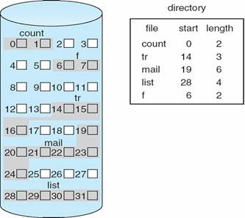
Contiguous Allocation

Slide 26

Linked Allocation

Slide 27
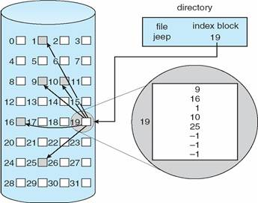
Indexed Allocation

Slide 28

Free Space Management
1. Bit Vector => 1 for block[i] free, 0 ⇒ block[i] occupied
2. Linked List – free space managed through linked list
3. Grouping – first n-1 block is made free
4. Counting – first block will have the count of the free blocks

Slide 29
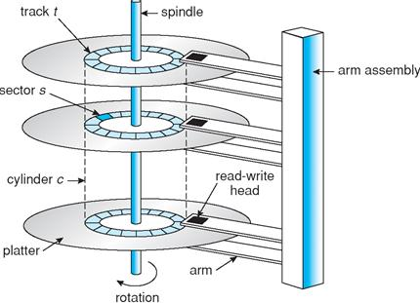
Overview of Mass Storage

Slide 30
Disk Structure
Magnetic disks provide bulk of secondary storage of modern computers:
Drives rotate at 60 to 200 times per second
Transfer rate is the rate at which data flow between drive and computer
Positioning time is time to move disk arm to desired cylinder (seek time) and time for desired sector to rotate under the disk head (rotational latency)
Head crash results from disk head making contact with the disk surface
Disks can be removable

Slide 31
Disk Structure
Disk drives are addressed as large 1-dimensional arrays of logical blocks, where the logical block is the smallest unit of transfer
The 1-dimensional array of logical blocks is mapped into the sectors of the disk sequentially.
Sector 0 is the first sector of the first track
Mapping proceeds in order through that track, then the rest of the tracks in that cylinder and then through the rest of the cylinders from outermost to innermost.

Slide 32
Disk Scheduling Algorithms
The operating system is responsible for using hardware efficiently.
For the disk drives, this means having a fast access time & disk bandwidth.
Access time has two major components:
Seek time is the time for the disk to move the heads to the cylinder containing the desired sector
  Rotational latency time waiting for the disk to rotate the desired sector to the disk head
We like to minimize seek time.

Slide 33
Disk Scheduling Algorithms
Disk bandwidth is the total number of bytes transferred divided by
the total time between the first request for service and the completion of the last transfer.
Several algorithms exist to schedule the servicing of disk I/O requests.

Slide 34
FCFS
We illustrate them with a Request Queue (cylinder range 0-199):
98, 183, 37, 122, 14, 124, 65, 67
Head pointer: cylinder 53
Illustration shows total head movement of 640 cylinders

Slide 35
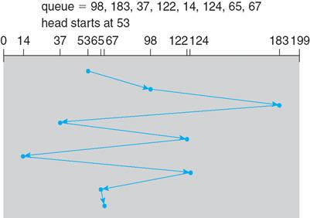
FCFS

Slide 36
SSTF
Selects the request with the minimum seek time from the current head position
SSTF scheduling may cause starvation of some requests
Illustration shows total head movement of 236 cylinders

Slide 37
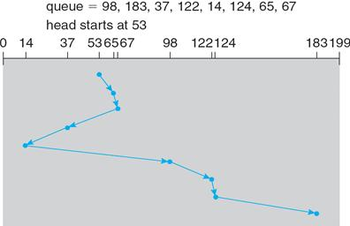
SSTF

Slide 38
SCAN
The disk arm starts at one end of the disk, and moves toward the other end, servicing requests until it gets to the other end of the disk, where the head movement is reversed and servicing continues.
SCAN algorithm sometimes called the elevator algorithm.
Illustration shows total head movement of 208 cylinders

Slide 39
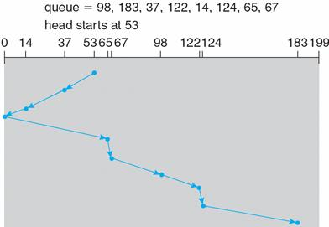
SCAN

Slide 40
C-SCAN
Provides a more uniform wait time than SCAN
The head moves from one end of the disk to the other, servicing requests as it goes
When it reaches the other end, however, it immediately returns to the beginning of the disk, without servicing any requests on the return trip.
Treats the cylinders as a Circular list that wraps around from the last cylinder to the first one

Slide 41
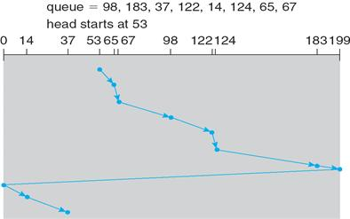
C-SCAN

Slide 42
Look
LOOK scheduling improves upon SCAN by looking ahead at the queue of pending requests, and not moving the heads any farther towards the end of the disk than is necessary.

Slide 43
C-LOOK
Version of C-SCAN
Arm only goes as far as the last request in each direction, then reverses direction immediately, without first going all the way to the end of the disk.

Slide 44
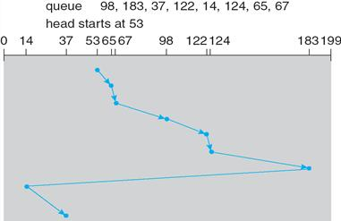
C-LOOK

Slide 45
Selecting a Disk-Scheduling Algorithm
SSTF is common and has a natural appeal
SCAN and C-SCAN perform better for systems that place a heavy load on the disk

Slide 46
Exercise on Disk Scheduling
Suppose that a disk has 5000 cylinders, numbered 0 to 4999. The drive is currently serving a request at cylinder 143, and the previous request was at cylinder 125. The queue of pending requests is:
86,1470,913,1774,948,1509,1022,1750,130
Starting from the current head position, what is the total distance that the disk arm moves to satisfy all the pending requests for the following disk-scheduling algorithms?
  FCFS
  SSTF
  SCAN

Slide 47
Protection
Protection refers to a mechanism for controlling the access of programs, processes, or users to the resources defined by a computer system.
Protection ensures that the resources of the computer are used in a consistent way.
It ensure that each object accessed correctly and only by those processes that are allowed to do so.

Slide 48
Goals of Protection
We need to provide protection for several reasons.
The most obvious is the need to prevent the mischievous, intentional violation of an access restriction by user.
An unprotected resource cannot defend against use (or misuse) by an unauthorized or incompetent user. A protection-oriented system provides means to distinguish between authorized and unauthorized usage.

Slide 49
Cont…
Provide a mechanism for the enforcement of the policies governing resource use.
      These policies can be established in a variety of ways.
- fixed in the design of the system
      - formulated by the management of a system
      - individual users
      A protection system must have the flexibility to enforce a variety of policies.

Slide 50
Principles of Protection
The time-tested guiding principle for protection is the Principle of least privilege. It dictates that programs, users, and even systems be given just enough privileges to perform their tasks.
An operating system following the principle of least privilege implements its features, programs, system calls, and data structures so that failure or compromise of a component does the minimum damage and allows the minimum damage to be done.
The principle of least privilege can help produce a more secure computing environment.

Slide 51
Domain of Protection
A computer system is a collection of processes and objects. By objects, we mean both hardware objects (such as the CPU, printer) and software objects(such as files, programs).
Each object has a unique name that differentiates it from all other objects in the system, and each can be accessed only through well-defined and meaningful operations.

Slide 52
Cont…
A process should be allowed to access only those resources for which it has authorization Furthermore, at any time, a process should be able to access only those resources that it currently requires to complete its task.

Slide 53
Domain Structures
A process operates within a Protection Domain that specifies the resources that the process may access.
Each domain defines a set of objects and the types of operations that may be invoked on each object.
The ability to execute an operation on an object is an access right.

Slide 54
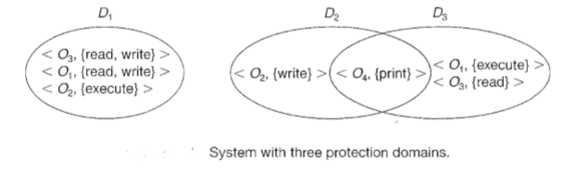
Cont…
For example, if domain D has the access right <file F, {read, write}>, then a process executing in domain D can both read and write file F; it cannot, however, perform any other operation on that object.

Slide 55
Cont…
A domain can be realized in a variety of ways:
Each user may be a domain. In this case, the set of objects that can be accessed depends on the identity of the user.
Each process may be a domain. In this case, the set of objects that can be accessed depends on the identity of the process.
Each procedure may be a domain. In this case, the set of objects that can be accessed corresponds to the local variables defined within the procedure.

Slide 56
Access Matrix
Protection can be viewed abstractly as a matrix, called an Access Matrix. The rows of the access matrix represent domains, and the columns represent objects. Each entry in the matrix consists of a set of access rights.

Slide 57
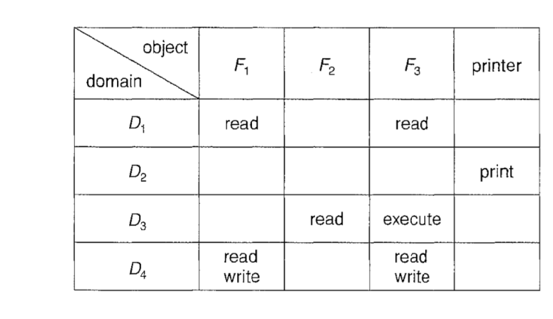
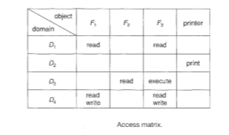
Access Matrix:

Slide 58
Use of Access Matrix
If a process in Domain D_{i} tries to do “op” on object O_{j}, then “op” must be in the access matrix
User who creates object can define access column for that object
Can be expanded to dynamic protection
  Operations to add, delete access rights
  Special access rights:
    owner of O_{i}
    copy op from O_{i} to O_{j} (denoted by “*”)
    control – D_{i} can modify D_{j} access rights
    transfer – switch from domain D_{i} to D_{j}
  Copy and Owner applicable to an object
  Control applicable to domain object

Slide 59

Access Matrix of Figure A with Domains as Objects

Slide 60

Access Matrix with Copy Rights

Slide 61

Access Matrix With Owner Rights

Slide 62

Modified Access Matrix of Figure B

Slide 63
Implementation of Access Matrix
Generally, a sparse matrix
Option 1 – Global table
  Store ordered triples <domain, object, rights-set> in table
  A requested operation M on object O_{j} within domain D_{i} -> search table for < D_{i}, O_{j}, R_{k} >
    with M ∈ R_{k}
  But table could be large -> won’t fit in main memory
  Difficult to group objects (consider an object that all domains can read)

Slide 64
Implementation of Access Matrix (Cont.)
Option 2 – Access lists for objects
  Each column implemented as an access list for one object
  Resulting per-object list consists of ordered pairs <domain, rights-set> defining all domains with non-empty set of access rights for the object
  Easily extended to contain default set -> If M ∈ default set, also allow access

Slide 65
Implementation of Access Matrix (Cont.)
Each column = Access-control list for one object
Defines who can perform what operation
Domain 1 = Read, Write
Domain 2 = Read
Domain 3 = Read
Each Row = Capability List (like a key)
For each domain, what operations allowed on what objects
      Object F1 – Read
      Object F4 – Read, Write, Execute
      Object F5 – Read, Write, Delete, Copy

Slide 66
Implementation of Access Matrix (Cont.)
Option 3 – Capability list for domains
  Instead of object-based, list is domain based
  Capability list for domain is list of objects together with operations allows on them
  Object represented by its name or address, called a capability
  Execute operation M on object O_{j}, process requests operation and specifies capability as parameter
  Capability list associated with domain but never directly accessible by domain
    Rather, protected object, maintained by OS and accessed indirectly
    Like a “secure pointer”
    Idea can be extended up to applications

Slide 67
Implementation of Access Matrix (Cont.)
Option 4 – Lock-key
  Compromise between access lists and capability lists
  Each object has list of unique bit patterns, called locks
  Each domain as list of unique bit patterns called keys
  Process in a domain can only access object if domain has key that matches one of the locks

Slide 68
Comparison of Implementations
  Global table is simple, but can be large
  Access lists correspond to needs of users
    Every access to an object must be checked
      Many objects and access rights -> slow
  Capability lists useful for localizing information for a given process
    But revocation capabilities can be inefficient
  Lock-key effective and flexible, keys can be passed freely from domain to domain, easy revocation

